Slide 1
Reconstruction and Regression Loss for Time-Series Transfer Learning
Norwegian University of Science and Technology
Ask Sommervoll
30.10.2020
Notes:
In this paper the autors try to solve the problem of making time series classifiers and regressors performing poorly due to lacking clean data. CNNS have in the past few years shown promise on smaller datasets due a novel technique called transfer learning.
In this paper the authors present a new architecture and a new loss function for time-series transfer learning that outperforms baseline methods used in practice.

Slide 2
Motivation
LSTMs (1997) -Require a great deal of data
Transfer learning for image classification -Learned features effectively applied to different dataset
First layer features -General, appear to be universal regardless of dataset.
Important to make effective use of TS-data
Notes:
Recently LSTMs have been the go to method for solving time-series tasks. These require a great deal of data to reweight appropriately, which is a luxury often not afforded to time series tasks.
Transfer learning has been shown to be very effective for image classification, despite Deep nets also requiring large amounts of data.
First layer features which always resember gabor filters appear to be general for all tasks, allowing for effective transfer learning, ergo not wasting data for training the general

Slide 3
Problem
How can transfer learning be effectively applied to time series?
Notes:
Also: many domains have very poor/scarce/sparse data, so how can this be handled in an efficient way.

Slide 4
Related work
Transfer learning for image, language and video
Pre trained weights for seq2seq language models
Notes:
There has so far been little other work done in this space, most of what has been done for simpler DL/CNN tasks, which has worked well. This is the first work done on implementing the ideas of transfer learning to the domain of time series analysis.
The reason so little work has been done in this domain is because the idea of transfer learning is fairly new, and time series analysis functions in a very different way than for example DCNNs, as their structure is heavily focused on what happened previously, and with this latent temporal dependency arise new challenges.

Slide 5
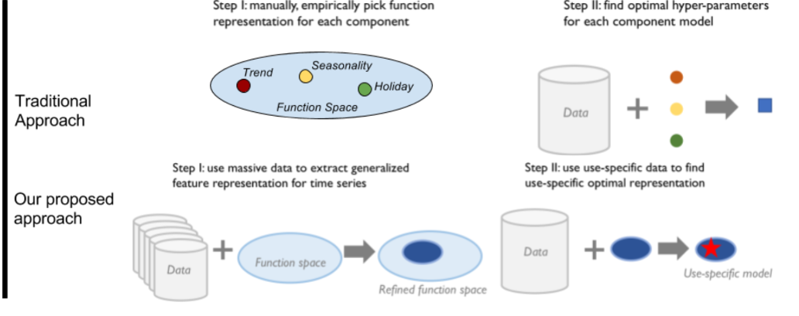
Methods
Notes:
The idea is fairly straightforward; instead of constructing function representation by throwing all you relevant data at it, you use lots of data to create a smaller, refined function space, then tune that model using your specific data.

Slide 6
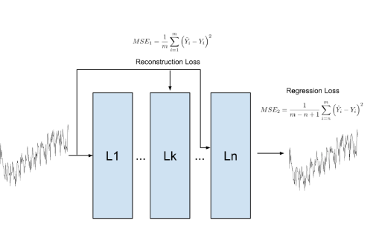
Model loss
Two types of loss: - Regression loss - Reconstruction loss
Notes:
Normally you only use one type of loss for example MSE, but this model implements two types of loss.
These are regression loss, which is simple MSE, and reconstruction loss. Reconstruction loss is a little more complicated and represents the likely that the input data would be reconstructed by the model. The motivation behind this is explicitly compute the modeling loss and the forecasting loss separately.
L1 consists of flully connected layers to extract time-series features
L2 Bottleneck layer where reconstruction loss is computed
L3 LSTM layers which use the output of the fully connected layer as input to perform the prediction and compute the forecasting loss.

Slide 7
Experimental setting
Train general features on large anonymized dataset for power consumption across the united states(i.e. in varied non-specific climates)
Also test on the M3 dataset from the M-competition
All data is log transformed and min-max scaled to [0,1]
Deep LSTM model, 3 fully connected layers and 6 LSTM cells. 128-dimensional state vector, time horizon 60h

Slide 8
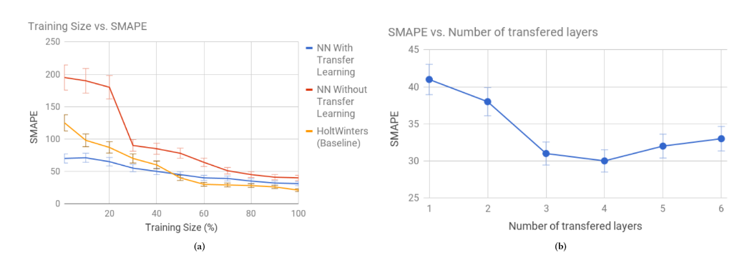
Results
Set size effect
Layer transferability
Notes:
SMAPE = Symmetric mean absolute percentage error
On small sets the performance of the transfer learning model dropped the SMAPE from around 200% to around 75% vs a *single* model. However as set size increases the performance converges
Performance also increases with transfer layer depth, but with diminishing returns.
Holt Winters is used a baseline for this test.

Slide 9
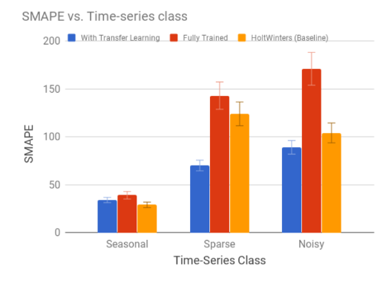
Results pt. 2
Notes:
Here we see the performance of the different models on various types of data-sets. Here the difference is the greatest, both in absolute terms and relatively between in sets with lacking or poor data, which is to be expected.

Slide 10
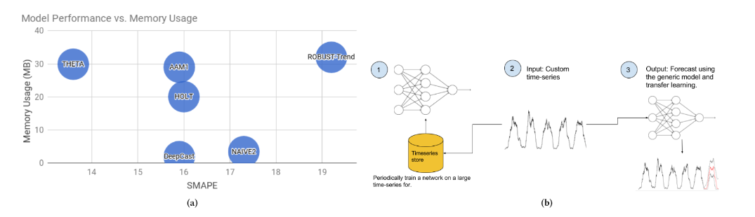
Results pt.3
Training time effects
Notes:
In current usage time series model are trained in their entirety on a per series basis, which in production is unsustainable due to increasing training times. By making use of transfer learning you can “skip” a large portion of this training time if you start with a partially fitted model.
B) Displays the democratization effects of periodically updating the generic store and network with new data

Slide 11
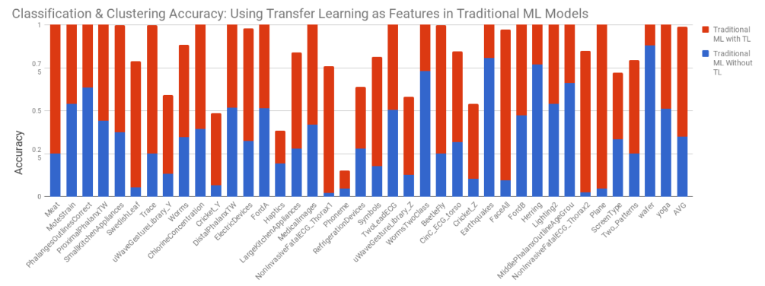
Results pt.4

Slide 12
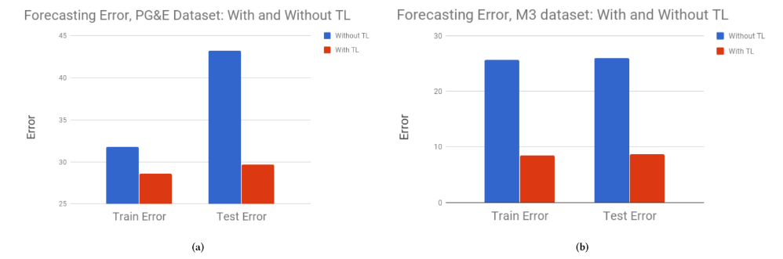
Results pt.5
Notes:
This is the data for the power consumption dataset and the M-competition dataset. This clearly shows the performance benefit

Slide 13
Conclusion
Scarce data
Transfer learning framework
Notes:
Transfer learning is an effective way to improve performance, especially on scarce, seasonal, temporal data
A transfer learning framework can greatly reduce training times and aid in making democratized general reference starting points.

Slide 14
Final thoughts
Interesting topic, can in theory be applied to any domain
May be applicable to my thesis
Open source/online tool open for everyone

